Slide 1

DEPARTMENT OF CSE (ARTIFICIAL INTELLIGENCE AND MACHINE LEARNING) ACADEMIC YEAR 2025 - 2026 SEMESTER III ARTIFICIAL INTELLIGENCE LABORATORY MINI PROJECT REVIEW MAP COLORING
REGISTER NUMBER | 2117240030056
NAME | JOENIT.J
YEAR | 2
SECTION | A
FACULTY IN-CHARGE | Mrs. M. Divya

Slide 2
PROBLEM STATEMENT
Overview: Map Coloring is a classic problem in Artificial Intelligence and graph theory where each region of a map must be colored so that no two adjacent regions share the same color.
Problem Definition: To color a map of North Indian states such that no two neighboring states have the same color, using the Hill Climbing optimization algorithm.
Objective:
Minimize color conflicts between adjacent states.
Achieve a valid coloring using a limited set of colors (Red, Green, Blue, Yellow).
Expected Output: A conflict-free coloring assignment for all states.

Slide 3
THEORETICAL BACKGROUND
Concepts Used:
Graph theory: representing states and their borders as a graph.
Constraint Satisfaction Problem (CSP): color assignment with adjacency constraints.
Hill Climbing: a local search algorithm that iteratively improves the solution by reducing conflicts.
Why Hill Climbing?
Simple and efficient for small-to-medium CSPs.
Works well for optimization problems with clear fitness measures (like minimizing conflicts).

Slide 4
IMPLEMENTATION AND CODE
Link to code in Git-hub Repository
Git Hub Link of the project and report | https://github.com/joenit2007-cmd/mapcoloring

Slide 5
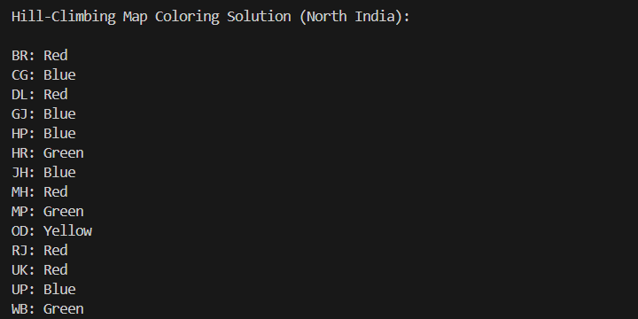
OUTPUT AND RESULTS

Slide 6
OUTPUT AND RESULTS
Explanation
The Hill Climbing algorithm colors the North Indian map by reducing color conflicts between neighboring states. It starts with random colors and iteratively improves until a valid, conflict-free solution is found.
Result
A correct coloring was achieved using four colors — Red, Green, Blue, and Yellow — with no neighboring states sharing the same color.
Future Enhancements
Use Simulated Annealing or Genetic Algorithms for better optimization.
Add a visual map display.
Test the algorithm on larger maps.

Slide 7
REFERENCES
References
Russell & Norvig – Artificial Intelligence: A Modern Approach
TutorialsPoint – Hill Climbing Algorithm in AI
GeeksforGeeks – Map Coloring Problem
Javatpoint – CSP and Local Search Algorithms
Medium Blog – AI Problem Solving Using Hill Climbing

